Slide 1
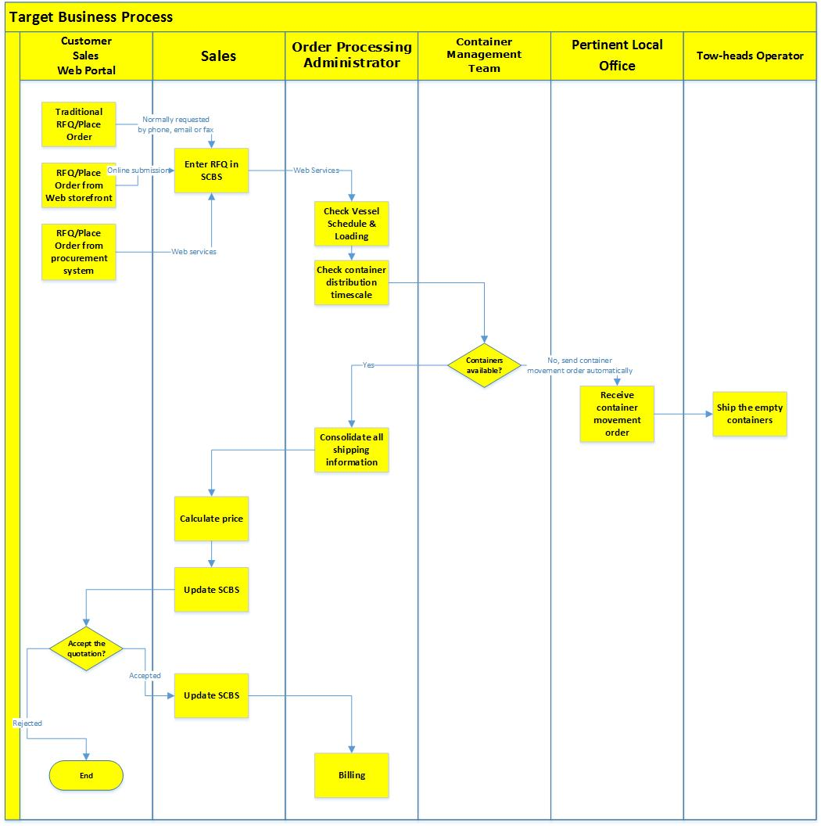
Phase 3
Phase 2
Phase 1

Slide 2
Phase 1
Phase 2

Slide 3
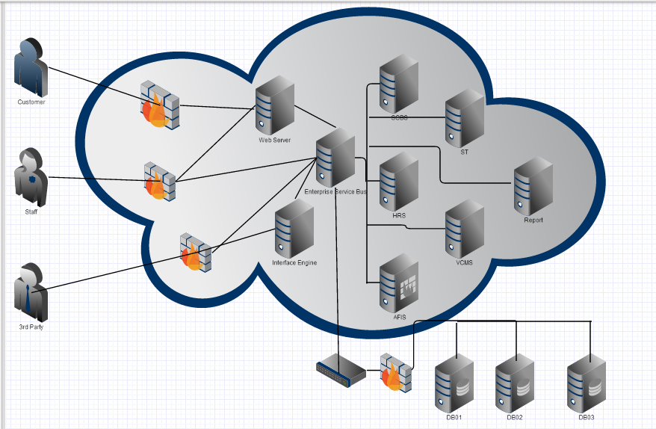
Phase 1
Phase 2
(Logical)
Phase 3
(Existing)
Phase 2
(Logical)
Phase 1

Slide 4
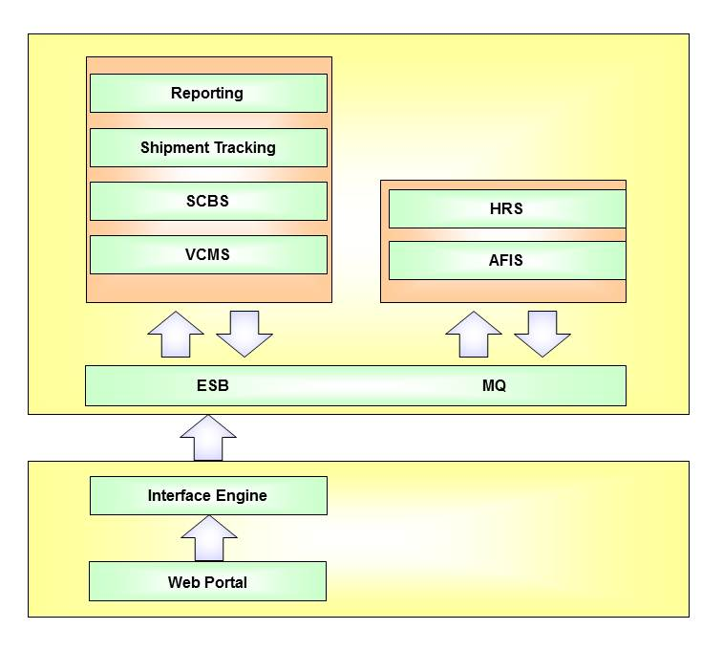
Phase 2
Phase 3
Phase 1

